Slide 1

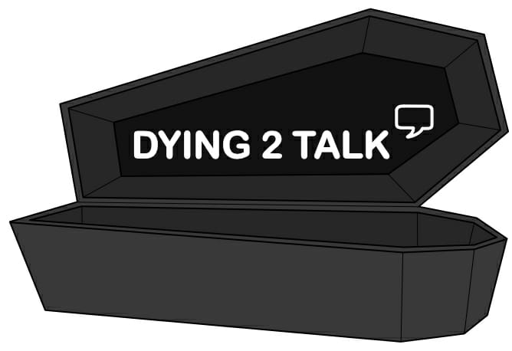

The role of archaeology on the Dying to Talk project
Aoife Sutton

Slide 2

Why did we use archaeology as part of the Dying to Talk project?
The Continuing Bonds project – AHRC project which ran between 2016-2018 - Dr Karina Croucher (University of Bradford – collaboration between archaeology and healthcare).
Used archaeology to open up conversations about death, dying and bereavement – workshops.
Successful in the context of Continuing Bonds – incorporated as an element of the Dying to Talk project.

Slide 3
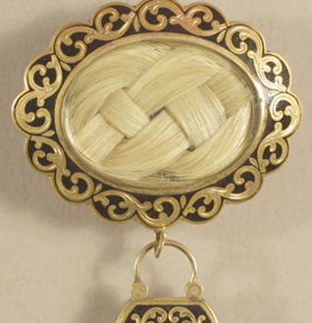
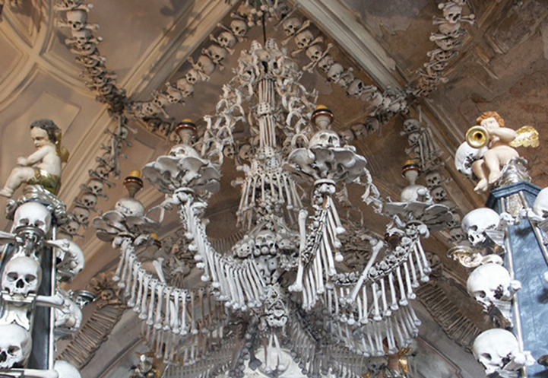
Our ambassadors and archaeology
Set an archaeological task for our ambassadors – similar to workshop prompt questions used during Continuing Bonds.
An excellent exercise in taking an accessible approach in discussing death.
Archaeology was an element that came up in resource development and co-production.

Slide 4
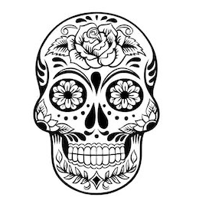
Archaeology and the developed resources
Colouring book – use of urns etc.
Death themed card game – archaeological examples.
Cemetery booklet with historical examples.

Slide 5
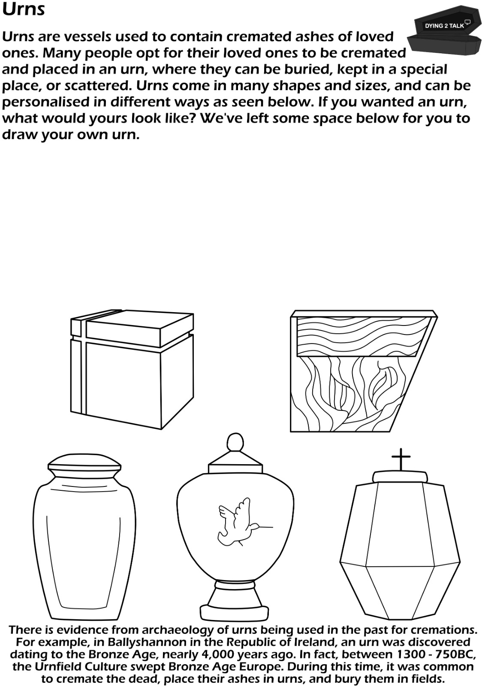
Colouring Book page example – archaeology incorporated in bottom paragraph.

Slide 6
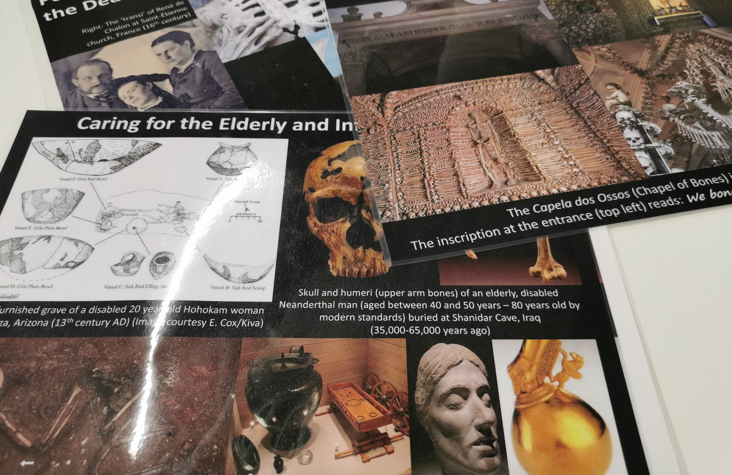
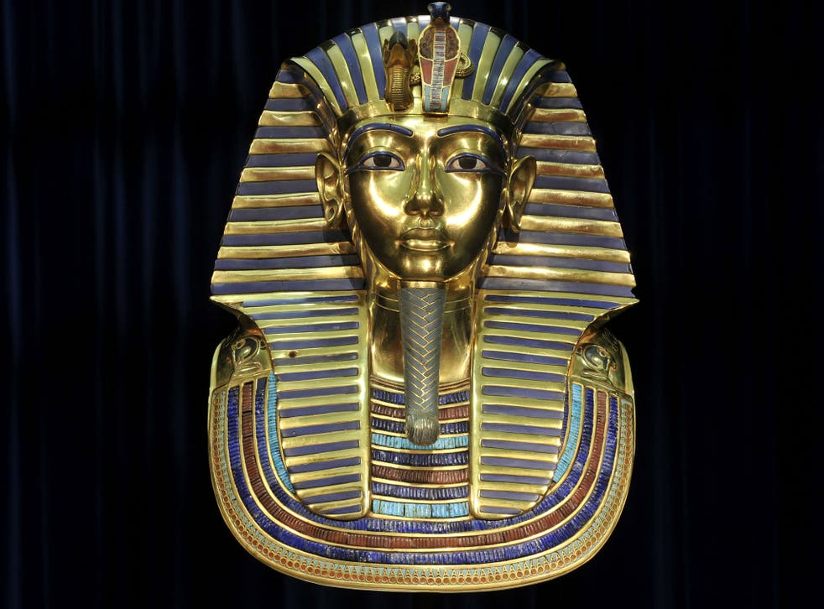
Our Festivals of the Dead and Archaeology
Archaeology and our activities: death mask painting, grave good sculpture, funerary jewellery making, tomb/ coffin painting, archaeological case studies (Continuing Bonds examples).

Slide 7
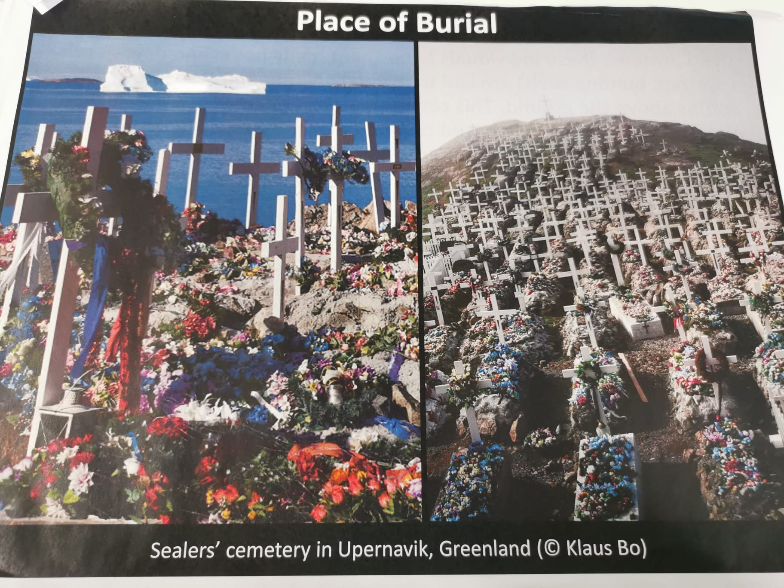
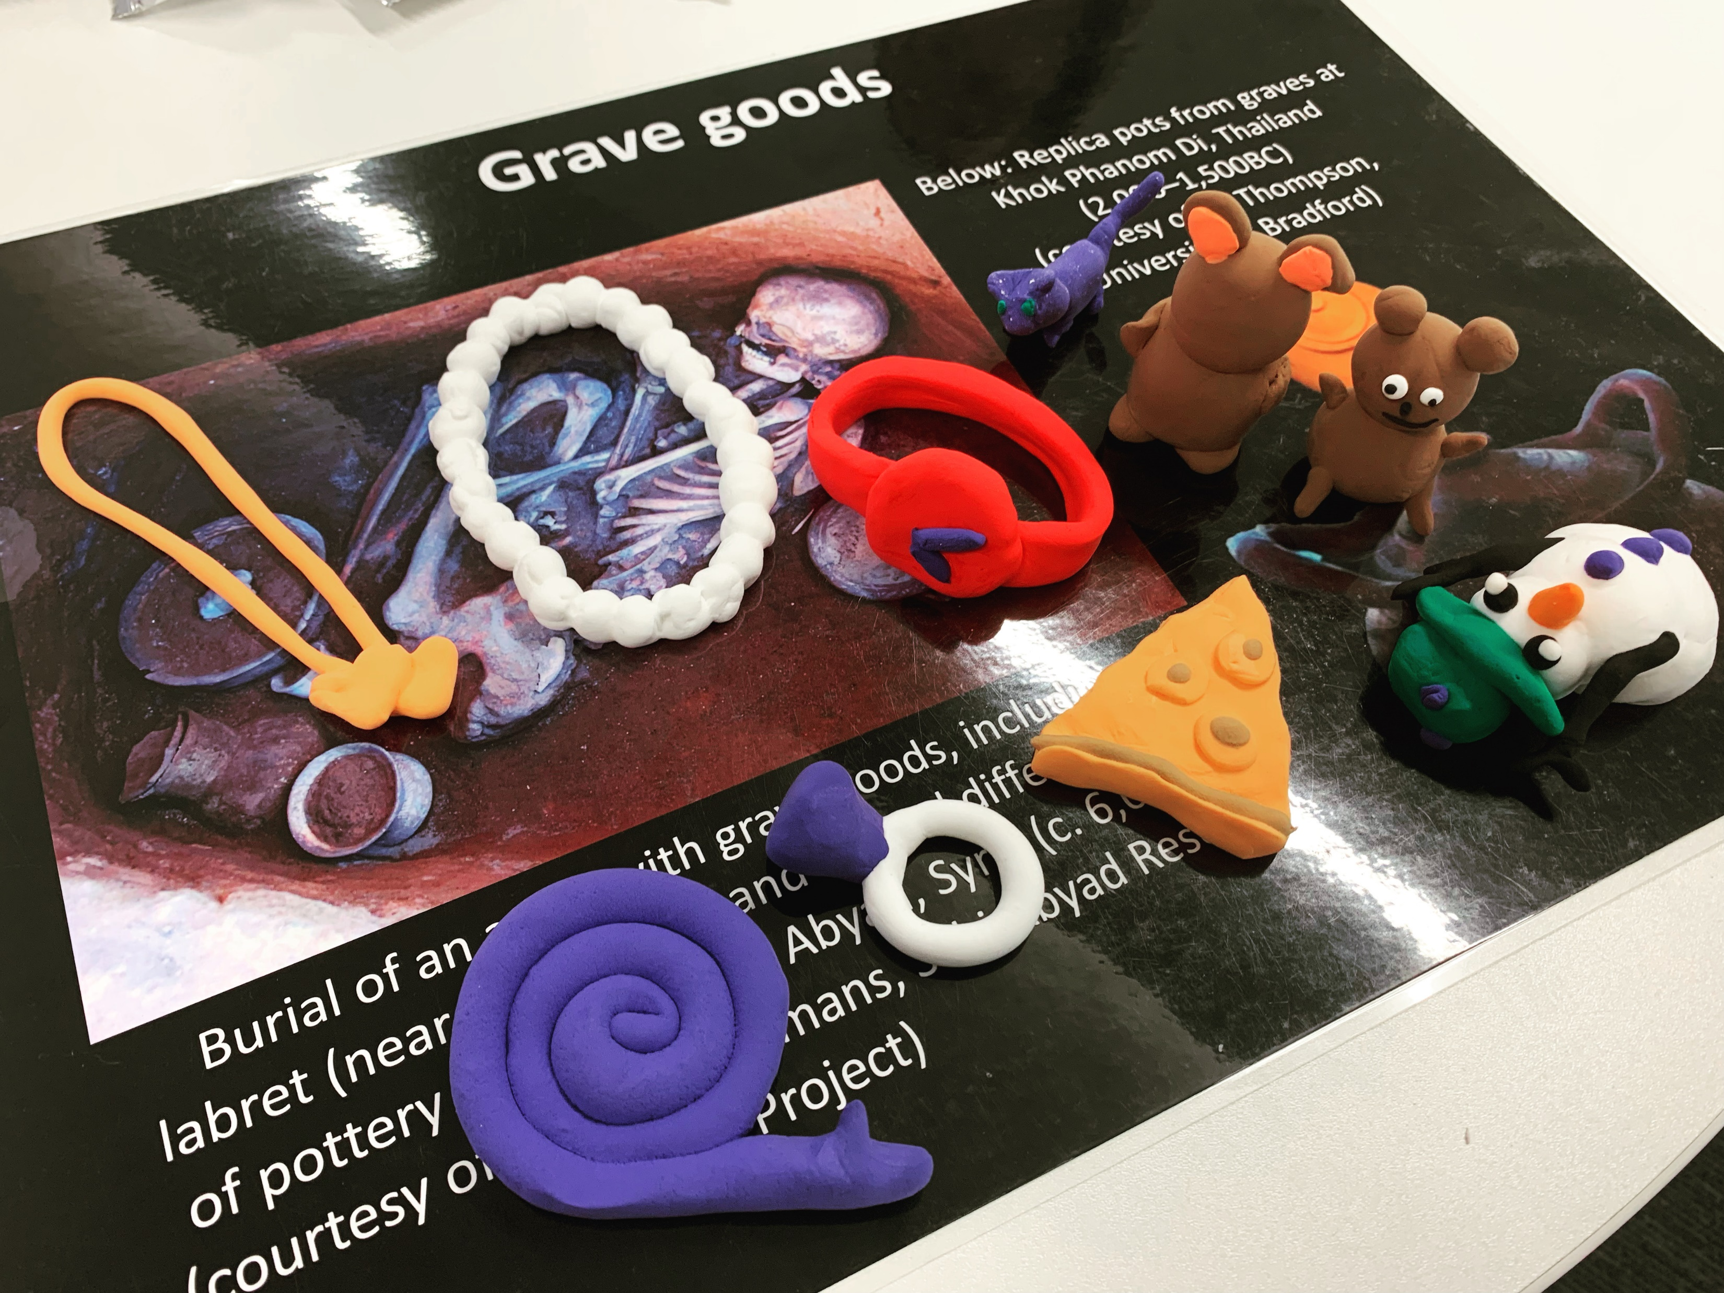
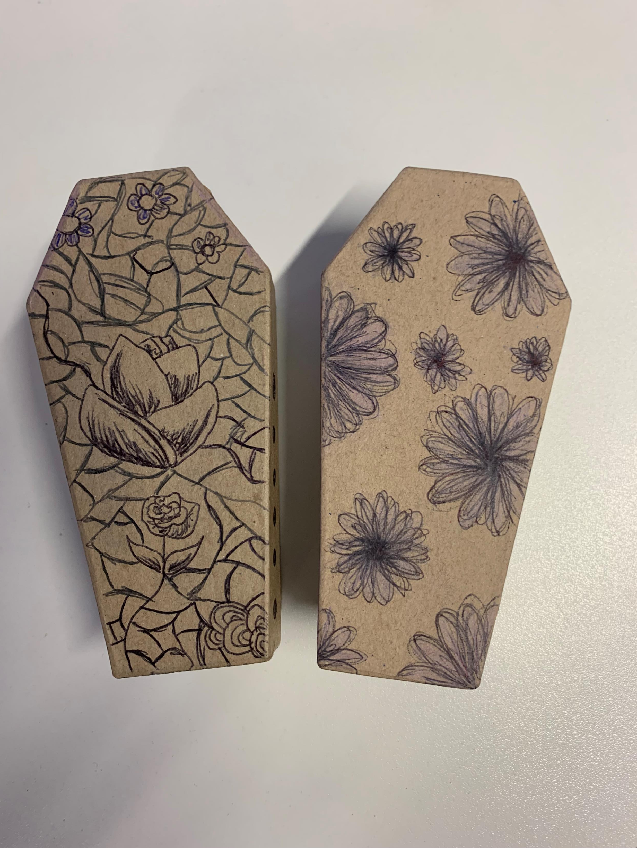
Our festivals of the Dead and Archaeology

Slide 8
Archaeology in the feedback: Quotes from ambassadors
‘The history and past traditions shown in archeology can tell us a lot about how people dealt with death in the past and how it’s changed’
‘Initially I thought it was purely about bones and fossils but it seems it’s a bit more than that, it tells a history and so much more is involved and I think it’s relevant to death and dying because it demonstrates options on how people can proceed with the inevitable.’
‘It helps others to relate to each other and bond over ancestors or be able to respect other cultures.’

Slide 9
Archaeology: how has it assisted?
A gateway topic – easily opens up conversations.
An interesting element incorporated into resource development and festival of the dead activities.
Met with enthusiasm from students and ambassadors.
Easily illustrates the variance in death practices in the past and relates to contemporary society.

Slide 10
Sources of interest: Archaeology
Büster, L.S., Croucher, K.T., Dayes, J.E., Green, L.I. and Faull, C., 2018. From plastered skulls to palliative care: what the past can teach us about dealing with death.
Croucher, K., 2018. Keeping the dead close: grief and bereavement in the treatment of skulls from the Neolithic Middle East. Mortality, 23(2), pp.103-120.
Croucher, K., Büster, L., Dayes, J., Green, L., Raynsford, J., Comerford Boyes, L. and Faull, C., 2020. Archaeology and contemporary death: Using the past to provoke, challenge and engage. PLoS One, 15(12), p.e0244058.

